Slide 1


Data Storage & Solutions CA1
Tim Browning & Clinton ngan

Slide 2
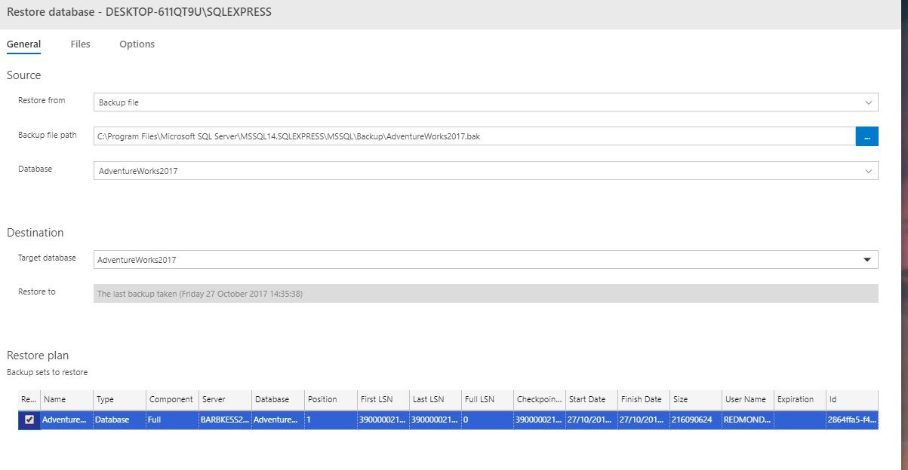
Restore AdventureWorks from backup
Notes:
- I used azure data studio to restore the database
Go through Each line
By restoring this database able to find all the views and tables and be able to deciide how to create the star schema

Slide 3
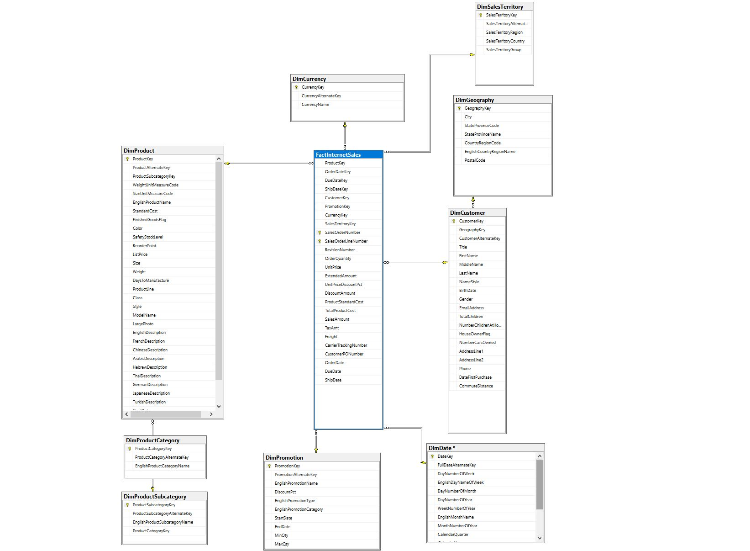
Designing a Star Schema
Notes:
Created in SSMS
We chose to do a “Sales” data warehouse
Dim Sales territory contains columns, DimGeography
The keys in the fact table relate to an associated row in a dimension table.
The only two tables are the Dimgeography that goes to Dimcustomer then factinternetsales and same for DimProductSubcategory, DimProductCategory – factinternetsales
asfd

Slide 4
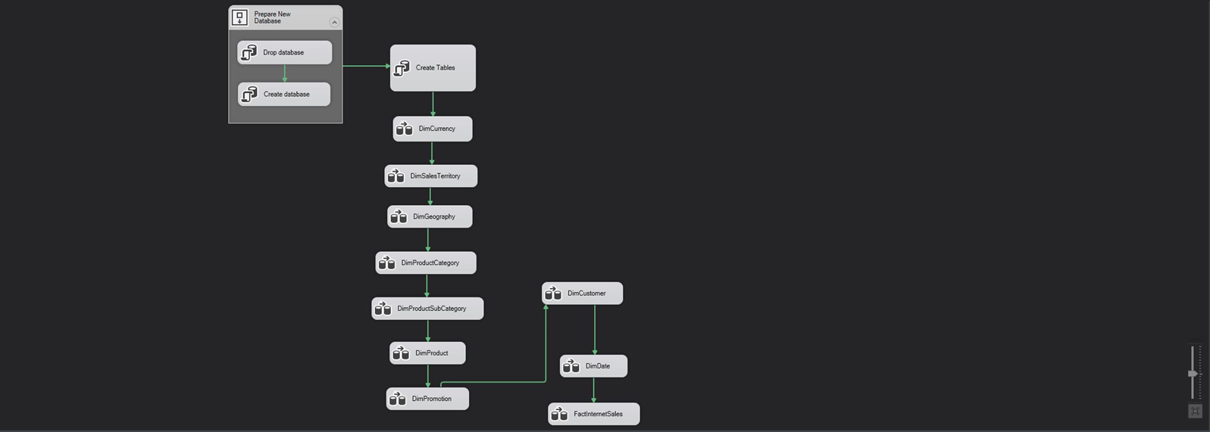
Creating the Data Warehouse

Slide 5
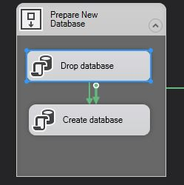
Creating the Data Warehouse
IF EXISTS (SELECT [name] FROM [master].[sys].[databases] WHERE [name] = N'AdventureWorksDWX ')
DROP DATABASE AdventureWorksDWX;
CREATE DATABASE [AdventureWorksDWX];

Slide 6
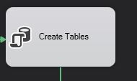
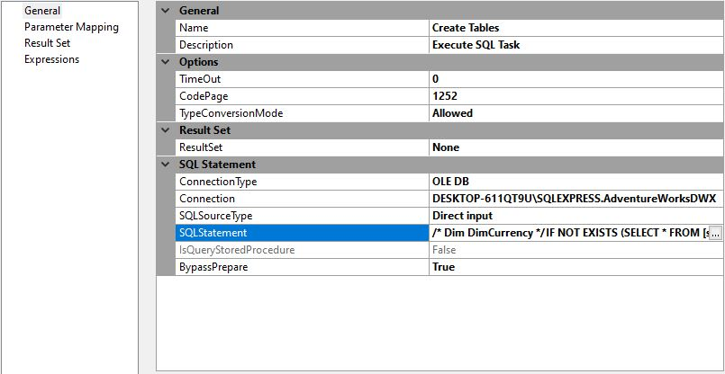
Creating the Data Warehouse

Slide 7
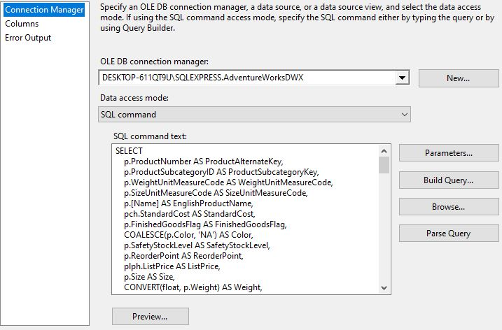
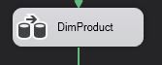
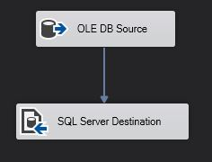
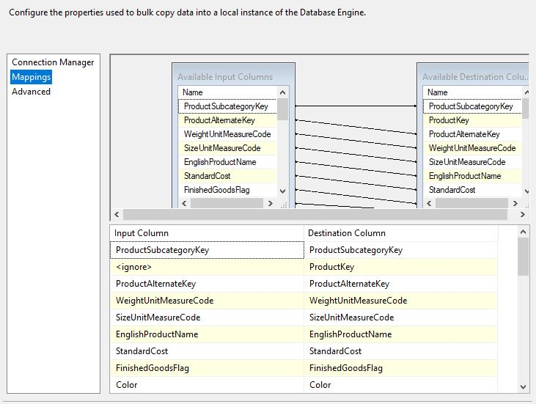
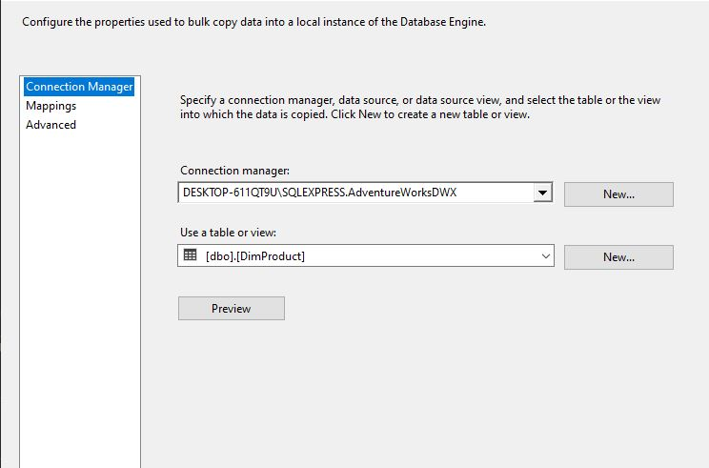
Creating the Data Warehouse

Slide 8
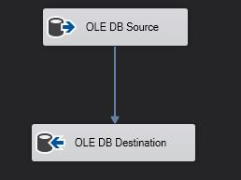
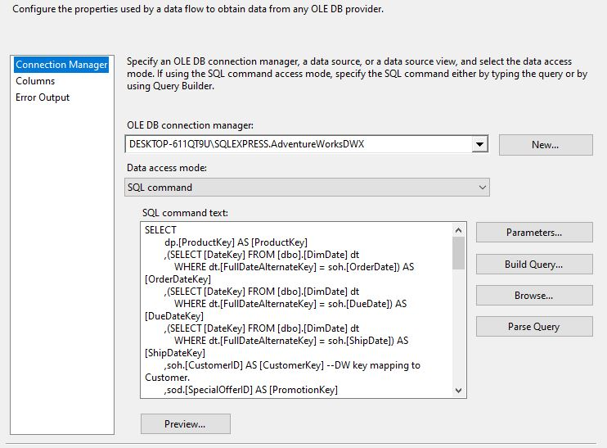

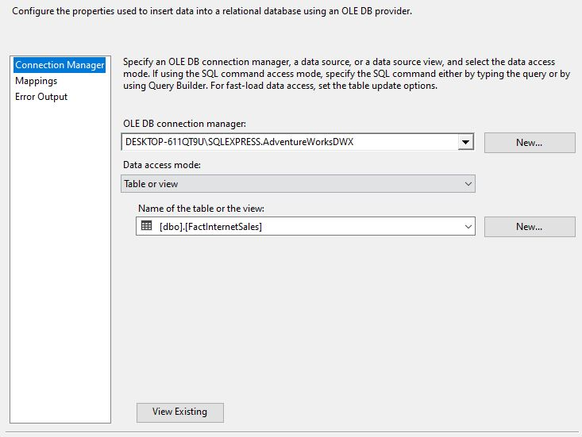
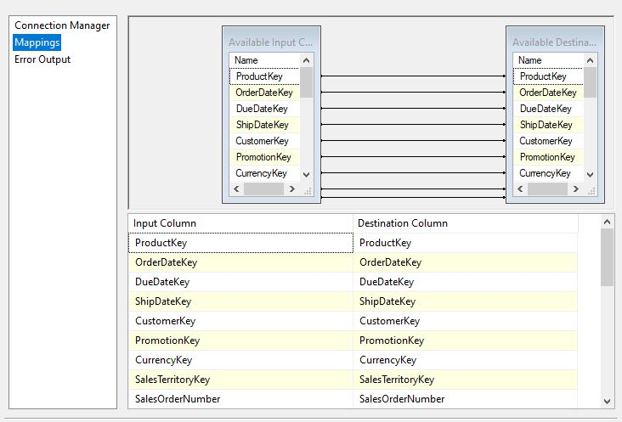
Creating the Data Warehouse

Slide 9
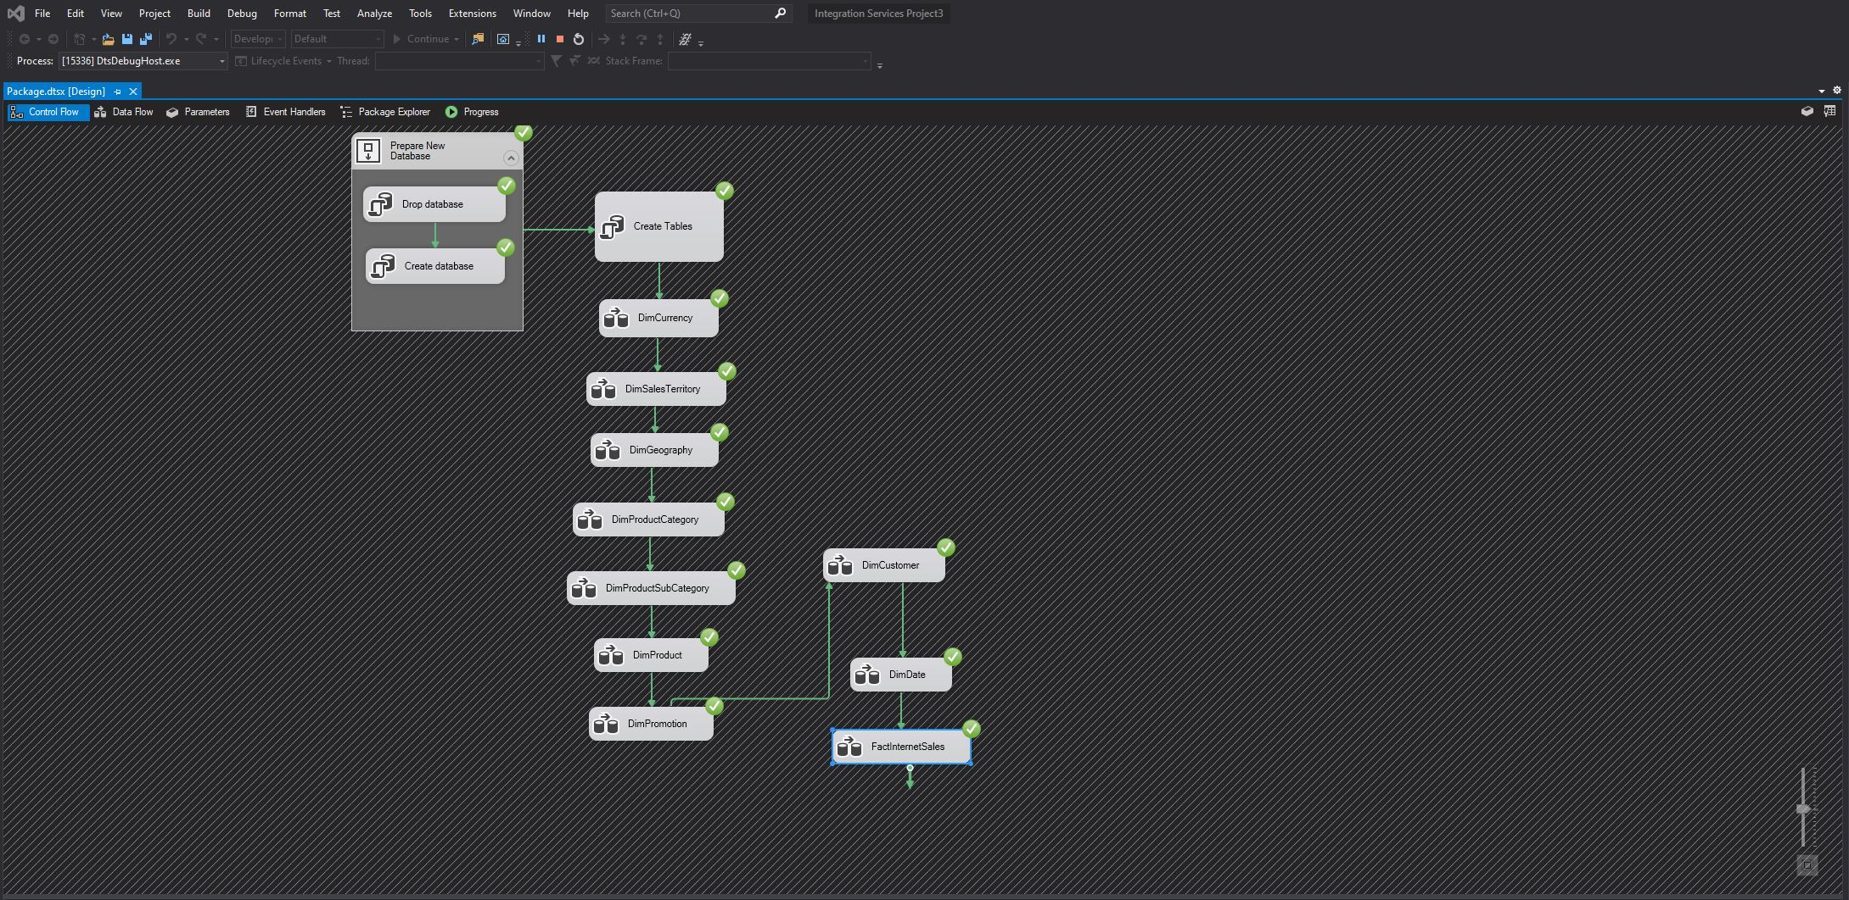
Creating the Data Warehouse

Slide 10
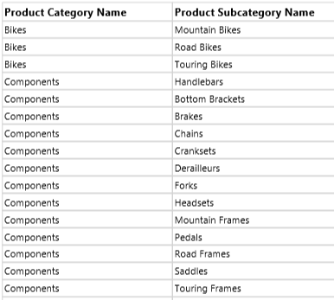
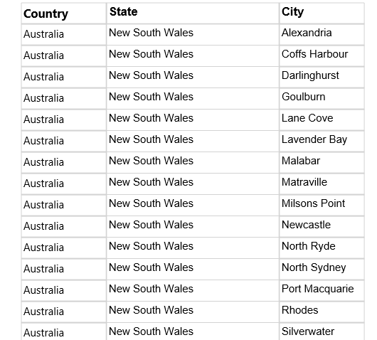
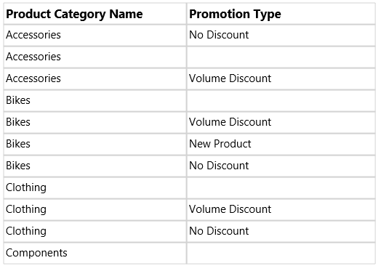
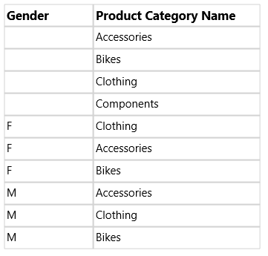
Exploring Data in SSRS (Visual Studio)
Product Category vs Subcategory
Geographic Information
Promotions for Categories
Gender & Products
Notes:
Getting a list of all Categories and what Subcategories exist in them
Getting a list of all Countries and seeing what states/cities exist in them
Getting a list of all Categories and what promotion types exists in them
Getting a list of Customer Genders and what they have purchased

Slide 11
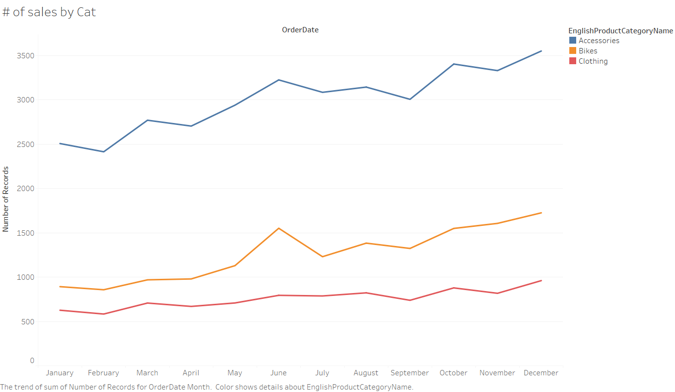
Exploring Data in Tableau
Order Amount By Date
Most orders are for “Accessories” and all three categories seem to have an uptake of orders around summertime
Overall number of orders also seem to increase towards end of year

Slide 12
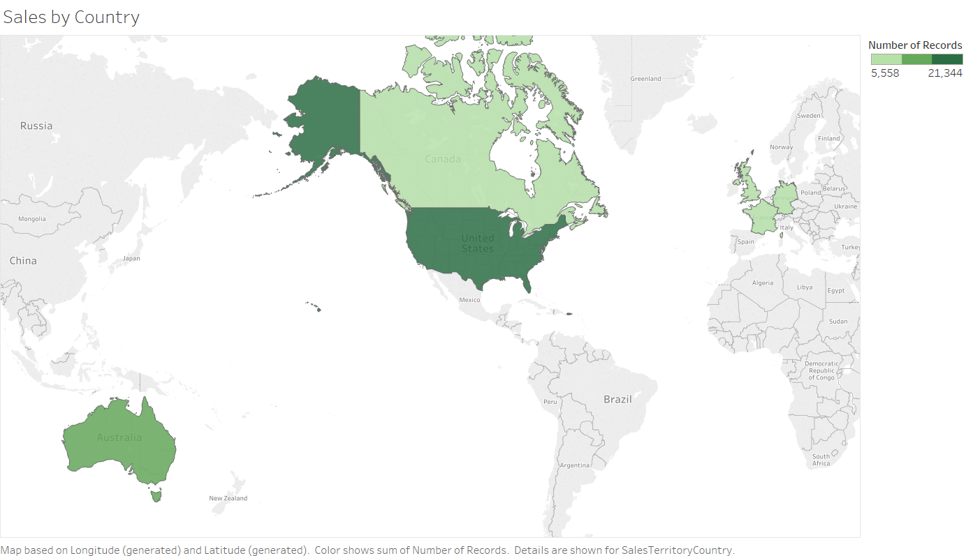
Exploring Data in Tableau
Order Amount By Location
Ranking for number of sales from highest to lowers:
America
Australia
Canada
Europe

Slide 13
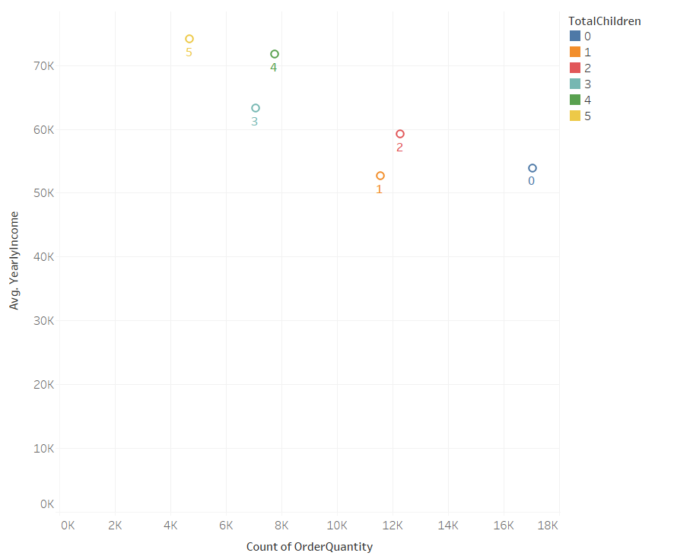
Exploring Data in Tableau
Order Amount & Avg Yearly Income By # of Children
The more kids a family has, the less they buy even though the higher income they earn on average
On the other hand, people with 2 or less kids earns less but are ordering more

Slide 14
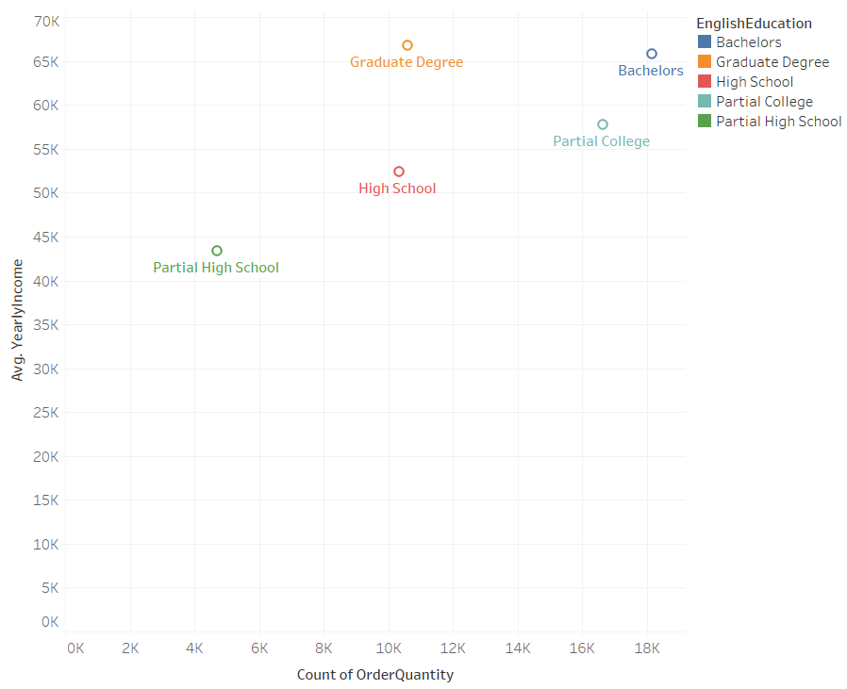
Exploring Data in Tableau
Order Amount & Avg Yearly Income By Education
Customers with the lowest education background (Partial HS) earn the least and are buying the least.
Interestingly, Graduate and Bachelors earn around the same amount on average, but Bachelors buy the most

Slide 15
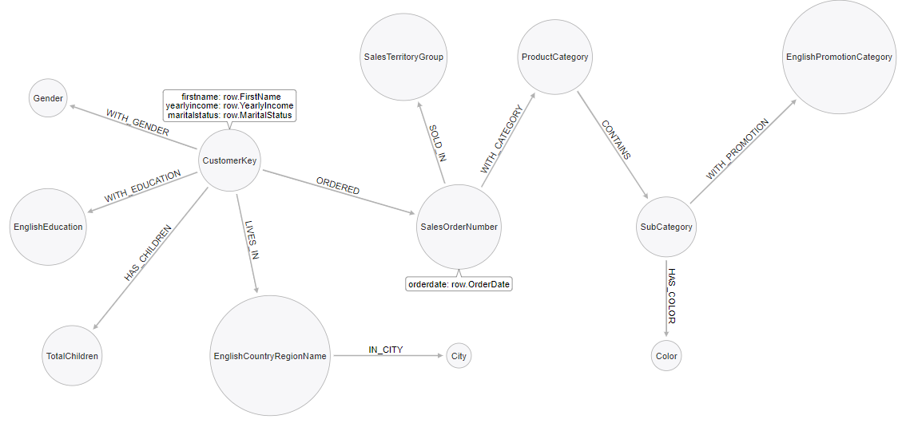
Importing Data in Neo4j
Used Arrow Tool to draft blueprint of database
Insert relationships and nodes into Neo4j
Notes:
12 nodes total
11 relationships

Slide 16
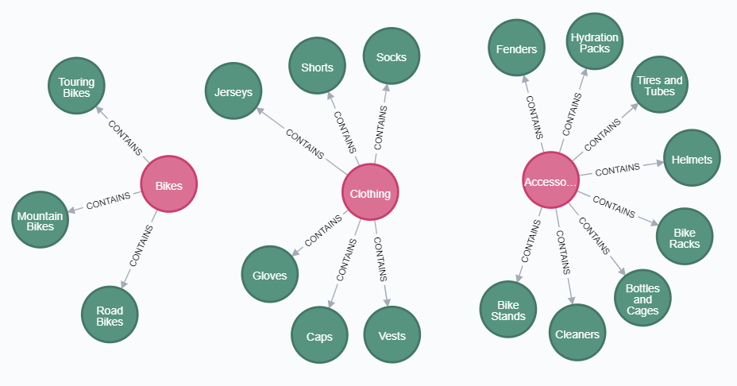
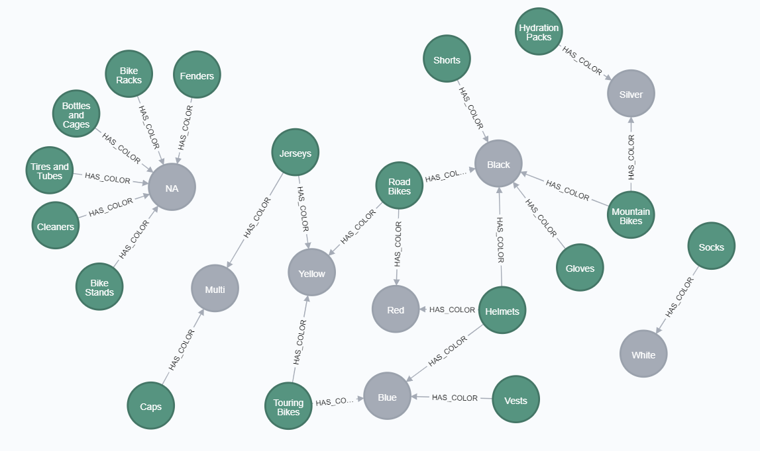
Exploring Data in Neo4j
Product Category vs Subcategory
Colors in Subcategory
Notes:
Looking at relationships between categories and subcat
Seeing what colors these products have and look for overlaps

Slide 17
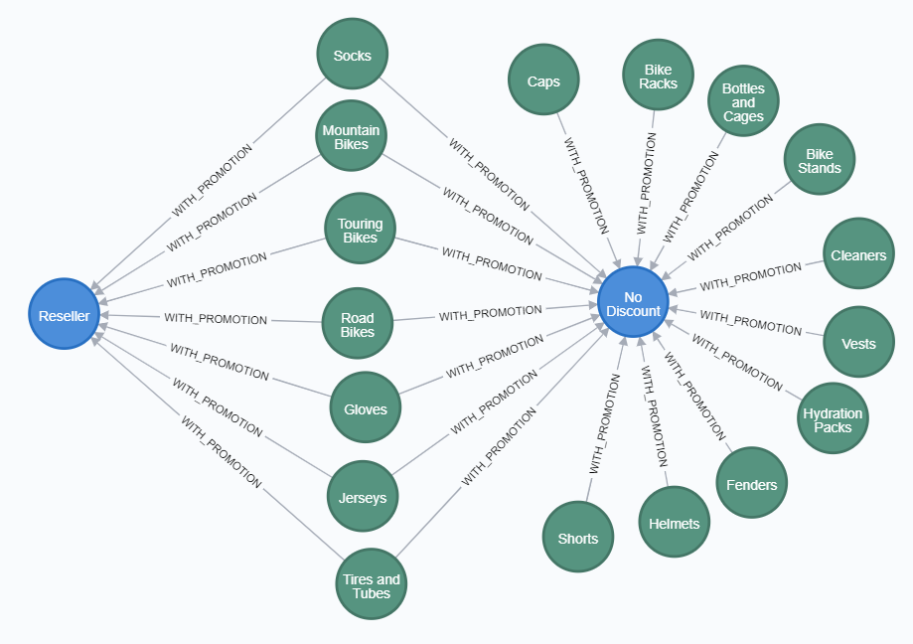
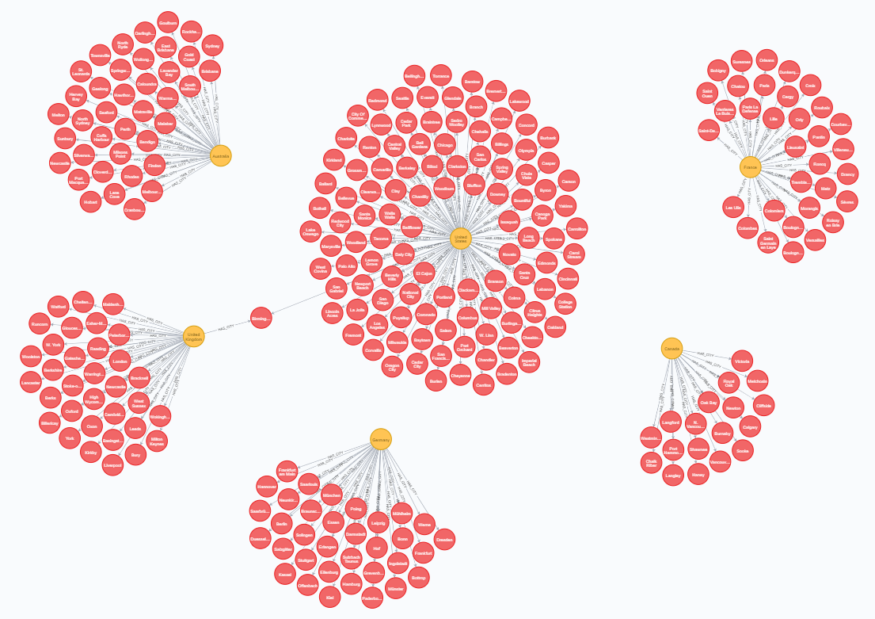
Exploring Data in Neo4j
Subcategory & Promotions
Countries and Cities
Notes:
Looking at promotions these subcategories have
Looking at countries and cities. Good exercise as we found out there’s a city that shares the same name and exists in two countries. Could potentially skew data if we only looked at city sales and didn’t filter the right countries

Slide 18
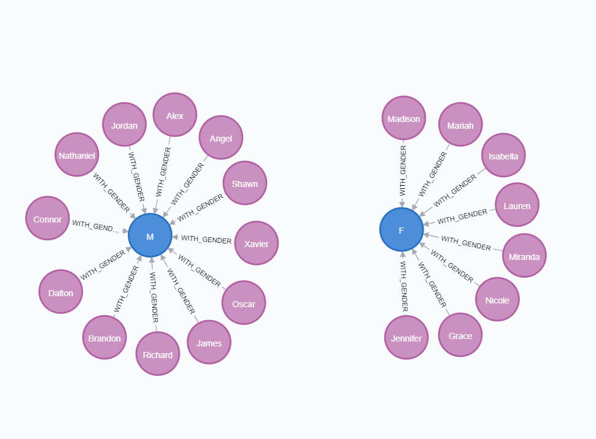
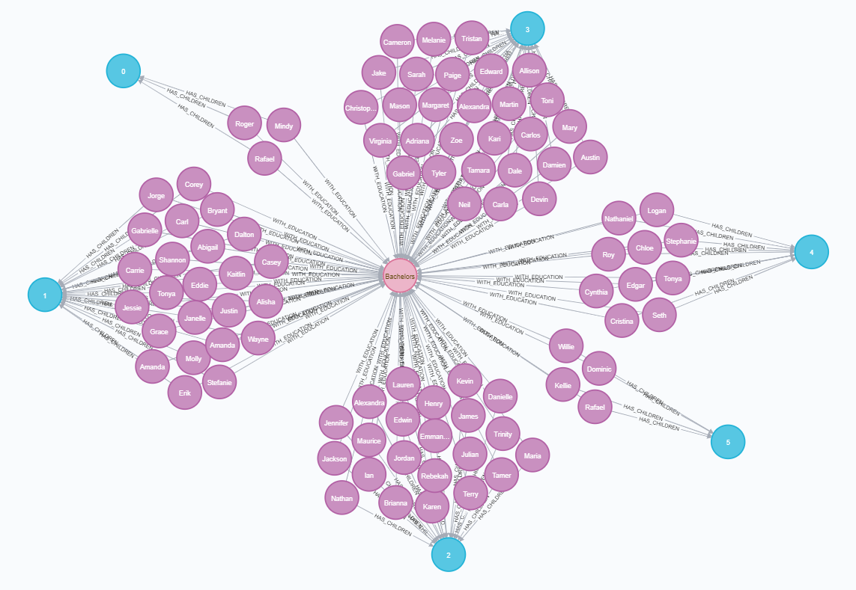
Exploring Data in Neo4j
Customers Within Conditions
# of Children for Customers Within Conditions
Notes:
Looking at customers genders who live in Canada, Single and have a yearly Income over 80,000
Looking at Customers who have a Bachelor's degree, Married and have a yearly income of 100k to see how many children they have by using

Slide 19
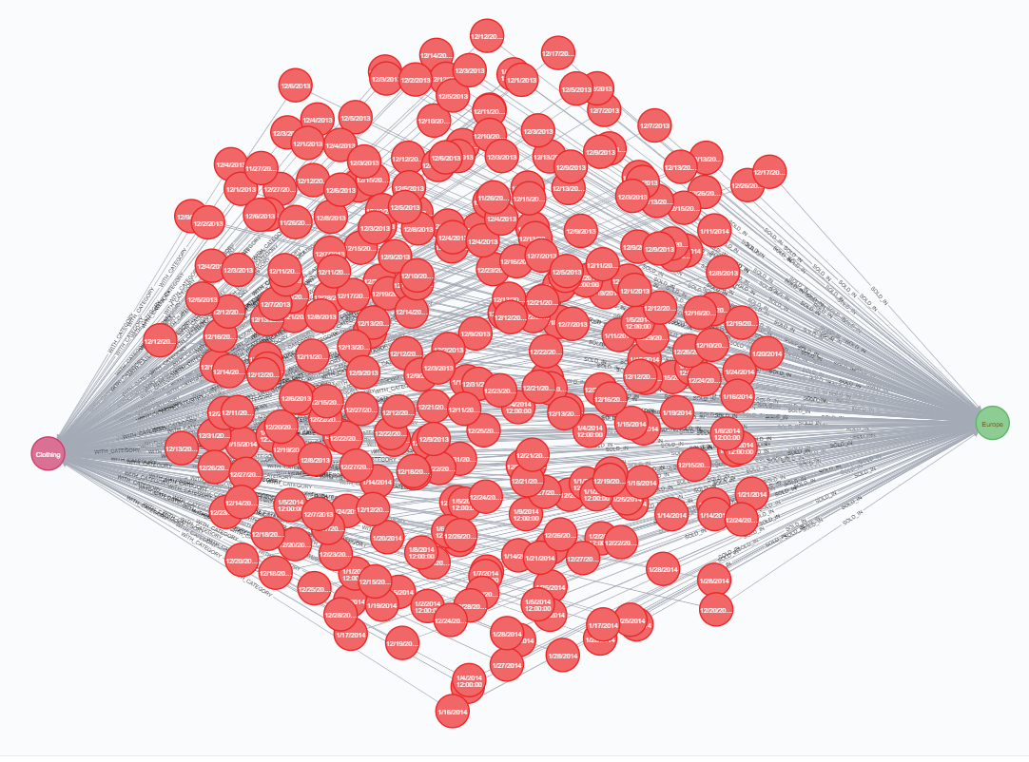
Exploring Data in Neo4j
Orders Within Conditions
Notes:
- Looking at all Clothing that were sold in Pacific and see individual orders

